Slide 1


Slide 2

The Idea
Get out
Get Social
Get fit

Slide 3

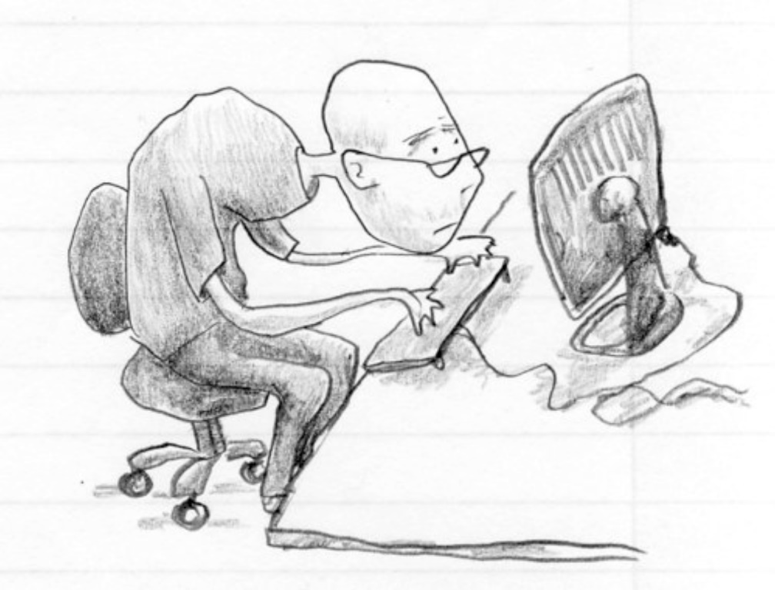
The Problem

Slide 4
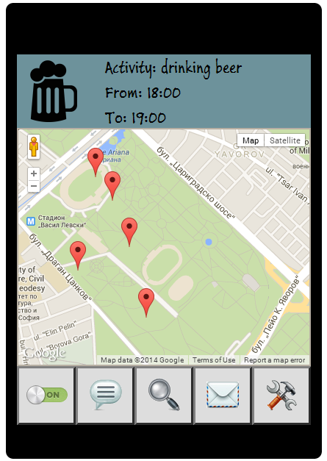
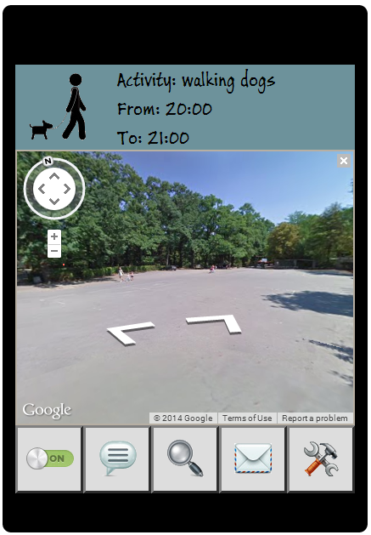
The Solution – Live Demo

Slide 5

? Questions ?

